Slide 1



Predicting Sector Price Movements Using Scientific Publication Trends

Slide 2




Problem Statement
Background
Problem Statement
Goal
Why?
Stock prices are often driven by emerging innovation and developments.
Scientific publications reflect real-time research activity and innovation focus.
Hence tracking these trends could offer early signals of sector momentum, ahead of financial indicators
Current investment strategies underutilize open-access scientific data.
Hence there’s a gap in tools that connect real-time research trends to short term sector performance.
The goal is to:
investigate whether fluctuations in publication and citation activity in key sectors can predict near-term stock price changes.
to deploy an interactive web application that helps investors connect scientific research trends with informed investment decisions.
Enables early detection of rising sectors for more informed investment decisions.
Does so by tapping into public scientific data — a rich, underexplored signal for market analysis.

Slide 3
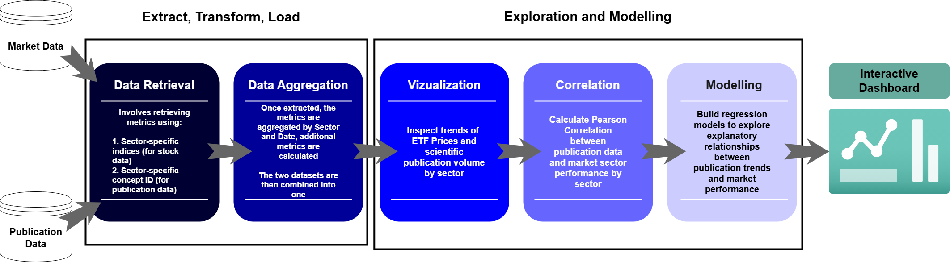
System Architecture

Slide 4





Data Sources and Assumptions
Data Source 1
Data Source 2
Assumptions
Concept IDs accurately represent sector-specific research topics.
Publication volumes and Citations are reasonable proxies for research activity and impact.
Data retrieved from OpenAlex is complete.
Publications can act as leading indicators of innovation, which subsequently affects stock movements.
Sector ETFs reflect broad investor sentiment and stock price movement.
Source of scholarly publication metadata.
Data includes publication date, citation count, publication type (journal etc), sector (through concept ID), open access status.
Source of sector-level financial data through sector ETFs.
Data includes date, open, high, low and close ETF prices, volume traded.
Focus on closing ETF price.
It reflects the consensus market price after the full trading day

Slide 5
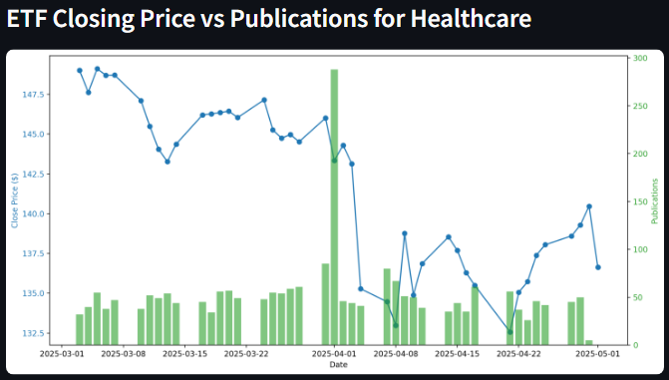
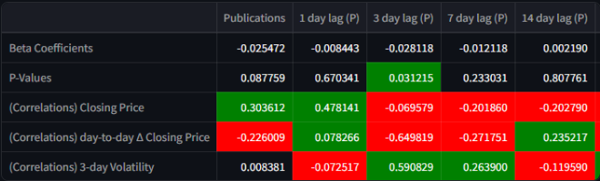
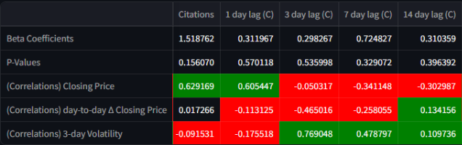
Insights
An increase in the number of publications 3 days prior results in a decrease in the day-to-day closing price changes.
The first two rows indicate the beta coefficients and p-values, respectively of the regression model: Publication + Lagged Publications + Citations + Lagged Citations ~ Day-to-Day Closing Price changes
The adjusted R² for this model is 31.44%.
An increase in the number of publications 3 days prior results in a decrease in the day-to-day closing price changes.
Most publication-related betas are negative, suggesting a potentially bearish short-term relationship.
Citation (3-day lag) is strongly correlated with volatility, indicating it may signal upcoming short-term price swings.

Slide 6


Next Steps and Limitations
Limitations
Future Improvements
OpenAlex rate limits and data granularity slow down analysis.
Research activity may correlate with ETF movements but not cause them. Other features may be needed to determine causes of stock price movements.
The analysis uses a linear regression framework which prioritizes simplicity over complexity.
Incorporate batch processing for Publication metadata retrieval
Leverage LLMs (sentiment analysis and classifiers) to classify research as positive or negative in aims to determine the impact of publication sentiment on stockprice movements
Investigate March/April spike in publications

